Slide 1

Selectors in jQuery

Slide 2
Why do we use selectors in jQuery?
Selectors allow you to select and manipulate HTML elements based on their attributes, content, or relationship in the DOM (Document Object Model).

Slide 3
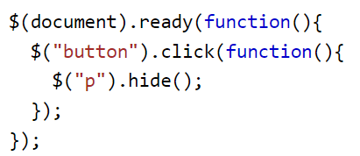
Element Selector
The jQuery element selector selects elements based on the element name.

Slide 4
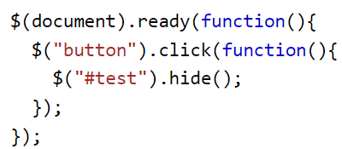
ID Selector
The jQuery #id selector uses the id attribute of an HTML tag to find the specific element. The “id” should be unique.

Slide 5
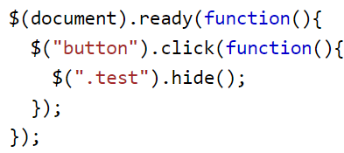
Class Selector
The jQuery .class selector finds elements with a specific class.

Slide 6

Hierarchy Selectors
Descendant Selector: Selects all elements that are descendants of a specified element.
For example, $('div p') selects all <p> elements within <div> elements.
Child Selector: Selects all direct child elements specified by a parent.
For example, $('ul > li') selects all <li> elements that are direct children of <ul>.

Slide 7
Attribute Selectors
Attribute Exists Selector: Selects elements that have a specific attribute, regardless of its value.
For example, $('[href]') selects all elements with an href attribute.
2. Attribute Equals Selector: Selects elements with an attribute that matches a specific value.
For example, $('[type="text"]') selects all elements with a type attribute equal to "text".

Slide 8
Filtering Selectors
First, Last, and nth-child: These selectors are used to select elements based on their position.
For example, $('li:first') selects the first <li> element.
2. :not Selector: Selects all elements that do not match the given selector.
For example, $('input:not([type="submit"])') selects all input elements except those with type="submit".

Slide 9
Form Selectors
:input, :text, :checkbox, etc.: These selectors are used to select form elements.
For example, $(':checkbox') selects all checkbox elements.

Slide 10
$(this)
In jQuery, $(this) is a concept that refers to the current jQuery object in the scope of the function in which it is being used. It is commonly used in event handlers and other functions to refer to the element that triggered the event or to distinguish between elements in a selection.
For Example:
<!DOCTYPE html>
<html lang="en">
<head>
<meta charset="UTF-8">
<title>jQuery $(this) Example</title>
<script src="https://ajax.googleapis.com/ajax/libs/jquery/3.5.1/jquery.min.js"></script>
<script>
$(document).ready(function(){
$("button").click(function(){
$(this).hide(); // Hides the button that was clicked
});
});
</script>
</head>
<body>
<button>Button 1</button> <button>Button 2</button>
<button>Button 3</button> </body>
</html>

Slide 11
Practical Applications of jQuery
DOM Manipulation: Easily find elements to manipulate their content, style, or attributes.
Event Handling: Attach event handlers to elements selected by various criteria.
Animation: Apply effects and animations to selected elements.
Form Validation: Quickly select and validate form elements based on their type or attributes.

Slide 12

THANK YOU

